Slide 1


SAP UI5 FIORI
Introduction to OData Services & CRUD
www.zarantech.com
© Copyright 2021, ZaranTech LLC. All rights reserved.

Slide 2

Disclaimer
2
This presentation, including examples, images, and references are provided for informational purposes only.
Complying with all applicable copyrights laws is the responsibility of the user.
Without limiting the rights under copyright, no part of this document may be reproduced, stored or introduced into a retrieval system, or transmitted in any form or by any means.
Credits shall be given to the images taken from the open-source and cannot be used for promotional activities.

Slide 3
Agenda
3
Introduction To OData Services
What Is Sap NetWeaver Gateway?
SAP NetWeaver Gateway Using OData Service
Introduction To Rest
REST Architectural Properties
Introduction To OData Formats
JSON Format And Features
What Is XML Format?
Structure Of OData Service
OData Operations

Slide 4

Introduction To OData Services
2
OData is a standardized protocol for creating and consuming data APIs.
OData builds on core protocols like HTTP and commonly accepted methodologies like REST.
The result is a uniform way to expose full-featured data APIs.
‹#›

Slide 5

Why OData?
2
The number of clients accessing the data have varied (smartphones, web, desktop) so has the technologies the clients are built in, so we needed a protocol which would send the data on standard format such as Json or Xml.
Most web services serve one purpose i.e. exposing data to the consumers hence this protocol becomes more relevant especially when you are creating a web service as just data provider.
‹#›

Slide 6
What is SAP NetWeaver Gateway?
2
SAP NetWeaver Gateway is used to setup a connection between SAP business suite and target clients, platforms and framework.
It offers development and generation tools to create OData services to different client development tools.
SAP NetWeaver gateway provides an easier way for the consumption on business logic and content for SAP Back-end system on web applications.
It also reduces the complexity to access SAP data and provides easy interfaces to decrease the development time.
‹#›

Slide 7
Key Features
2
Non-disruptive, any SAP business suite.
Ease to develop simple APIs and does not require any tool knowledge.
Allows connectivity to SAP applications using any programming language or model, without the need for SAP knowledge, by leveraging REST services and OData/ATOM protocols.
It provides plug-ins for well-known IDEs such as Eclipse, Visual Studio 2010 and XCode.
‹#›

Slide 8
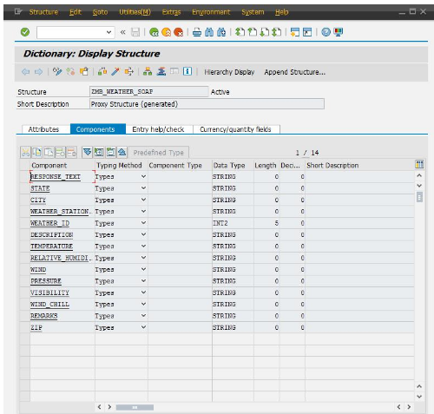
SAP NetWeaver Gateway Using OData Service
2
Step1: Create a structure in the data dictionary with the required input and output fields as none of the generated fields had both input and output fields in one structure using one of the structures as a template and add the ‘ZIP’ field.
‹#›

Slide 9
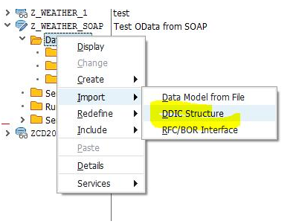
SAP NetWeaver Gateway Using OData Service
2
Step2: Now in the Service Builder, create a new project for our new OData service and import the DDIC structure that is just created.
The field ‘ZIP’ has to be defined as a ‘Key’ field in the usage column.
Now save the project and the system generates the empty classes for implementation.
‹#›

Slide 10
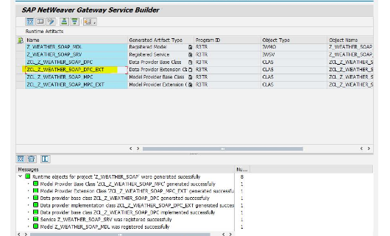
SAP NetWeaver Gateway Using OData Service
2
Step2: One of the generated classes is called xyz_DPC_EXT.
This is the extension class that was generated by the Service Builder.
Now, even if the OData model definition in the Service Builder is updated and the project re-generated, this extension class will not be overwritten.
‹#›

Slide 11
Introduction To REST
2
REpresentational State Transfer (REST) is an architectural style that defines a set of constraints to be used for creating web services.
REST API is a way of accessing web services in a simple and flexible way without having any processing.
REST technology is generally preferred to the more robust Simple Object Access Protocol (SOAP) technology because REST uses less bandwidth, simple and flexible making it more suitable for internet usage.
It’s used to fetch or give some information from a web service. All communication done via REST API uses only HTTP request.
‹#›

Slide 12
REST Architectural Properties
2
Performance
Portability
Scalability
Visibility
Simplicity
Reliability
Modifiability
‹#›

Slide 13
Introduction To OData Formats
2
Format
JSON is a simple, lightweight format with good support in many tools, but sometimes you would rather get XML.
XML is by no mean deprecated – it’s more than a format; you get a whole platform with capabilities useful for validations (XML schema), querying (XPath, XQuery), transformations (XSLT) and so on.
Or you simply have a component that accepts only XML and not JSON.
JSON
XML
10

Slide 14

Introduction To OData Formats
2
Fortunately OData services aren’t limited to JSON; they can return XML as well.
Simply add HTTP header Accept with value application/atom + xml, application/ atomsvc + xml, application/xml.
You’ll start getting the same data in XML format
‹#›

Slide 15
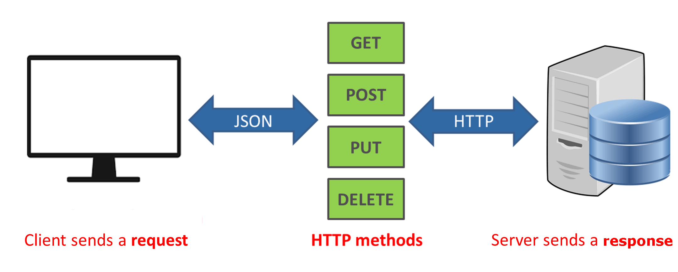
Introduction To OData Formats
2
12

Slide 16

What Is JSON Format?
2
JSON stands for JavaScript Object Notation.
JSON is an open standard data-interchange format.
JSON is lightweight and self-describing.
JSON originated from JavaScript.
JSON is easy to read and write.
JSON is language independent.
JSON supports data structures such as arrays and objects.
13

Slide 17
Features Of JSON Format
2
Simplicity
Interoperability
Openness
Extensibility
Self-Describing
Internationalization
14

Slide 18

What Is XML Format?
2
XML is a simple and powerful tool in this era of data flow between multiple applications.
XML is a self-descriptive markup language designed as per W3C (World Wide Web Consortium) recommendations.
It was designed to store and transport data via various web services connecting different applications and promoting data exchange.
15

Slide 19

Structure Of OData Service
2
Entity: An entity is a potentially empty resource that has either zero content elements or one content elements.
Entity type: An entity type describes a collection and has a name. In many cases, the names of the collection and the entity type are equal or related by some convention.
Entity set: An entity set represents a potentially empty resource of entries.
16

Slide 20
Structure Of OData Service
2
Property: A property is a typed element that represents a primitive typed data element, structured data, or a link to another resource.
Navigation property: Entity types can include one or more navigation properties. A navigation property is a specific type of property containing a link that presents an association instance.
Association: An association defines a relation between entity types. Recursive relations are allowed. Each association includes 2 association ends, which specify the entity types that are related and the cardinality rules for each end of the association.
17

Slide 21
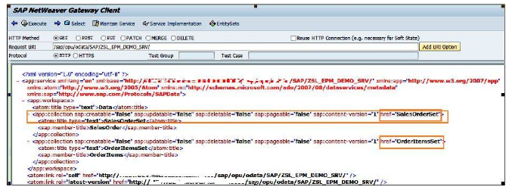
Structure Of OData Service
2
Service document: Service documents comprises of all list of resources URI’s that can be accessible.
18

Slide 22
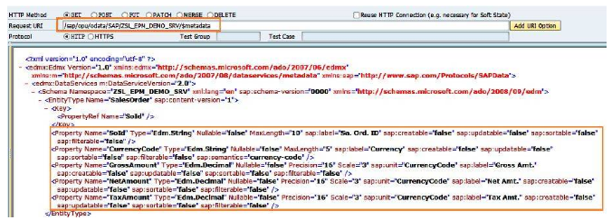
Structure Of OData Service
2
Service metadata document: Service metadata document contains meta data of all elements in the service.
19

Slide 23
Life Cycle Of OData
2
Activation of OData service.
Maintaining OData service.
Maintaining of models and services, up to the cleanup of the metadata cache.
RESTful applications use HTTP requests to post data to create or update, read data and delete data.
REST is a lightweight alternative to mechanisms like RPC (Remote Procedure Calls) and Web Services.
20

Slide 24
OData Operations
2
OData Operation | HTTP Method | Meaning
Create | POST | Insert <table> from <workarea>
Read | GET | Select Single * From <table> into <workarea>
Update | PUT/PATCH | Update <table> set <workarea>
Delete | DELETE | Delete from <table>
Query | GET | Select * from <table> Into Table
21

Slide 25

OData Operations
2
Filter: The $filter system query option allows clients to filter a collection of resources that are addressed by a request URL.
The expression specified with $filter is evaluated for each resource in the collection, and only items where the expression evaluates to true are included in the response.
E.g. All products with a Name equal to 'Milk': http://host/service/Products?$filter=Name eq 'Milk‘
22

Slide 26

OData Operations
2
Select: The $select system query option allows clients to request a specific set of properties for each entity or complex type.
E.g. Rating and release date of all products : http://host/service/Products?$select=Rating,ReleaseDate
It is also possible to request all declared and dynamic structural properties using a star (*).
All structural properties of all products: http://host/service/Products?$select=*
23

Slide 27
OData Operations
2
OrderBy: The $orderby system query option allows clients to request resources in a particular order.
Return all Products ordered by release date in ascending order, then by rating in descending order
GET http://host/service/Products?$orderby=ReleaseDate asc, Rating desc
Related entities may be ordered by specifying $orderby within the $expand clause.
Return all Categories, and their Products ordered according to release date and in descending order of rating
GET http://host/service/Categories? $expand=Products($orderby=ReleaseDate asc, Rating desc)
24

Slide 28

OData Operations
2
Top and Skip: The $top system query option requests the number of items in the queried collection to be included in the result.
The $skip query option requests the number of items in the queried collection that are to be skipped and not included in the result.
E.g. Get top 10 items
http://host/service/Products?$top=10
Skip first 10 items
http://host/service/Products?$skip=10
25

Slide 29

OData Operations
2
$Inlinecount: URI with a $inlinecount System Query Option specifies that the response to the request includes a count of the number of Entries.
Collection of Entries identified by the Resource Path section of the URI.
The count must be calculated after applying any $filter System Query Options present in the URI.”
26

Slide 30

OData Operations
2
Count: The $count system query option allows clients to request a count of the matching resources included with the resources in the response. The $count query option has a Boolean value of true or false.
E.g. Return, along with the results, the total number of products in the collection
http://host/service/Products?$count=true
The count of related entities can be requested by specifying the $count query option within the $expand clause.
http://host/service/Categories?$expand=Products($count=true)
27

Slide 31

OData Operations
2
Expand: The $expand system query option specifies the related resources or media streams to be included in line with retrieved resources.
Each expand Item is evaluated relative to the entity containing the navigation or stream property being expanded.
E.g. Expand a navigation property of an entity type: http://host/service/Products?$expand=Category
28

Slide 32
OData Operations
2
Format: The $format is omitted from the URL the behavior will generally be to return the results in XML.
If the directive specifies JSON and the server supports returning in JSON then the result will be returned in JSON
E.g. Omitting the $format
http://odata.netflix.com/v2/Catalog/Titles?$top=1
However by adding a $format directive the data will be returned as JSON
http://odata.netflix.com/v2/Catalog/Titles?$top=1&$format=json
29

Slide 33
Thank you
Subscribe to our Channel for more Informative Videos.
https://www.youtube.com/user/ZaranTech

